Slide 1
Home Business
Tax Advantages
Qualifications:
Intent to Make a Profit
Work your Business on a Regular/Consistent Basis
Run your Business like a Business

Slide 2
Home Business
Tax Advantages
Home Office Expense
BUP of Mortgage Interest or Rent
(including “home operating expenses”)
[IRS Publication 587]

Slide 3
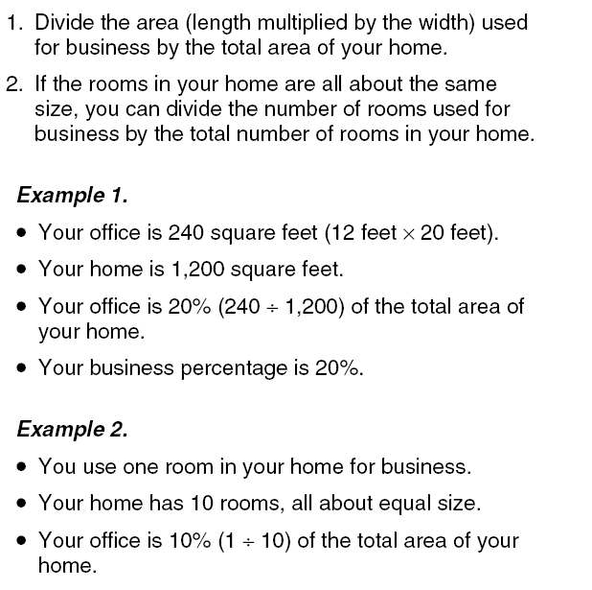
Home Business
Tax Advantages

Slide 4
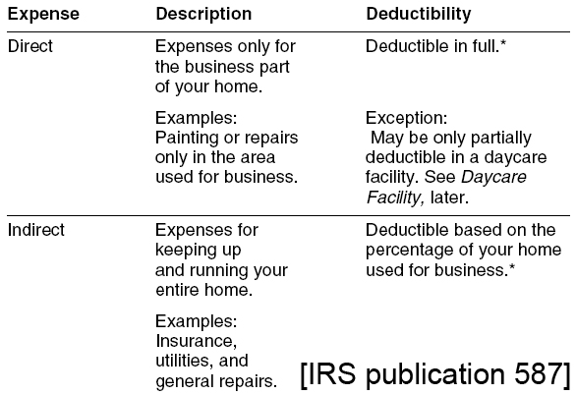
Home Business
Tax Advantages

Slide 5
Home Business
Tax Advantages
Home Office Equipment
Computer, Printer, Fax, Phone, etc.
[IRC Section 280 F(d)(4) and IRS Publication 956]

Slide 6
Home Business
Tax Advantages
Hire Your Kids
(don’t just pay them an allowance)
7-18yrs generally tax-free
Tax-Free Limit on earned income for dependent children in 2009 was $5,700
[Rev. Proc. 95-53 and IRC Section 63(h)(2)]

Slide 7
Home Business
Tax Advantages
Requirements for Hiring Minor Children:
Signed Employment Agreement
Form I-9
Form W-4
“Ordinary and Necessary” work
Document that services were actually performed (Signed Work Log)
Reasonable Wage Level (hourly rate)
Wages paid on a consistent basis (at least monthly)

Slide 8
Home Business
Tax Advantages
Vehicle Expense
Standard Mileage
$.50/mile
Actual Operating Costs

Slide 9
Home Business
Tax Advantages
No More “Vacations”
Just “Business Travel”
51% Rule [IRC Section 1.162-2(b)(2)]
“Business Day” [IRS Regulations 1.274-4(d)(2)(i)]
100% of Travel, Lodging, Taxis, Rental Cars, Tips [IRS Pub. 463]
Plus 50% of your meals on “business days” [Reg 1.162-2(a)]

Slide 10
Home Business
Tax Advantages
Meals and Entertainment Expenses
50% Deduction!

Slide 11
Home Business
Tax Advantages
Meals and Entertainment Expenses
Associated Entertainment
[Rev Reg 1.274-2(a) and (d)(3)]
[IRC 274(d)]

Slide 12
Home Business
Tax Advantages
Meals and Entertainment Expenses
When
How Much
Where
Why
Who

Slide 13
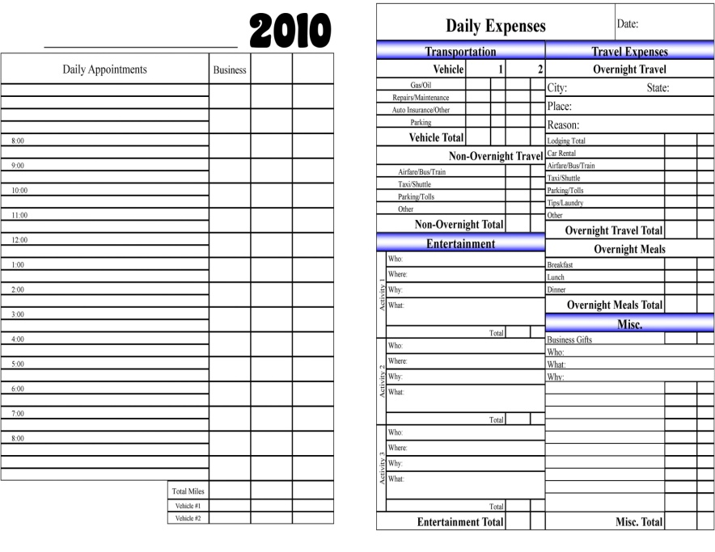
Home Business
Tax Advantages
Documentation

Slide 14
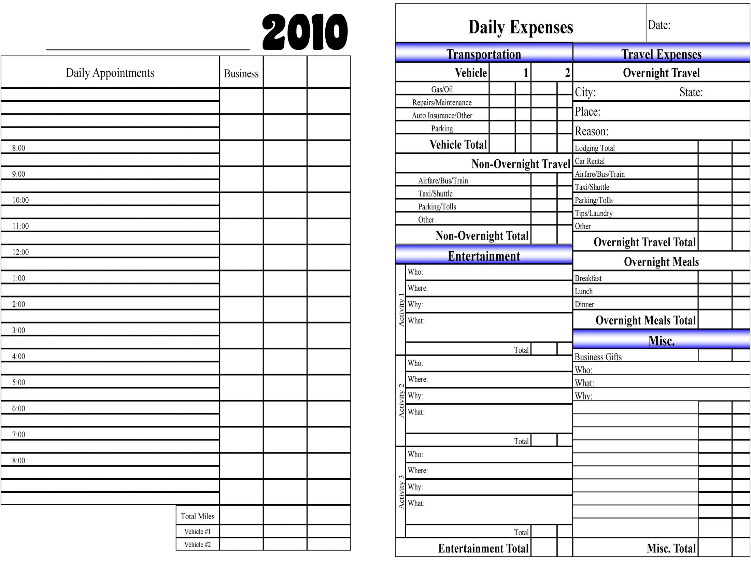
Home Business
Tax Advantages

